Slide 1


Time Series Forecasting & Demand Prediction for Favorita
Presented By:
Mohamed Abdelhamid
Rawan Asaad
Alaa Eid
Tarek Mohamed
Yosef Ahmed
Akram Gamal

Slide 2
Introduction

Slide 3
Introduction
Our project focuses on Sales and Demand Forecasting and Dynamic Pricing Optimization for retail businesses, using machine learning and reinforcement learning models. The system is designed to help business owners make informed decisions about product demand and pricing strategies, especially during seasonal peaks and special events.
We developed two core components:
A demand prediction model using XGBoost to forecast future demand based on historical data, promotions, holidays, and other contextual features.
A price optimization model using reinforcement learning to suggest whether to increase, decrease, or maintain prices to maximize revenue and customer satisfaction.
Additionally, we introduced a gamified challenge system where supermarket customers can participate by predicting future prices. Accurate predictions are rewarded with points, which can be redeemed for discounts—enhancing customer engagement and loyalty.

Slide 4
``
Goal:
The goal of this project is to develop a robust time series forecasting model to predict unit sales for items across Favorita grocery stores in Ecuador. By leveraging historical sales data, promotional information, and external factors such as holidays and oil prices.
the project aims to:
Enhance demand forecasting accuracy to anticipate customer needs more effectively
Support supply chain and inventory decisions by aligning stock levels with predicted demand
Enable data-driven promotional planning for both seasonal and regular campaigns
Explore the impact of price adjustments on overall revenue through dynamic pricing strategies

Slide 5
Data Collection, Exploration, and Preprocessing

Slide 6
Data Collection & Sources
Primary datasets: sales, stores, transactions, holidays, oil prices, train, test
Time range: 2013–2017
Merged datasets on shared keys (e.g., store_nbr, date)
Handled missing values in oil and holiday data

Slide 7
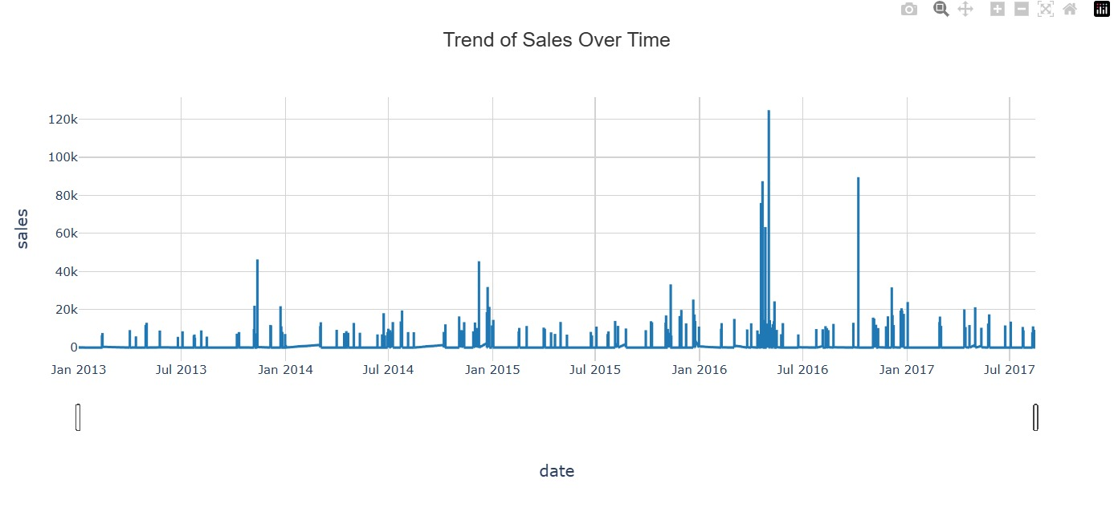
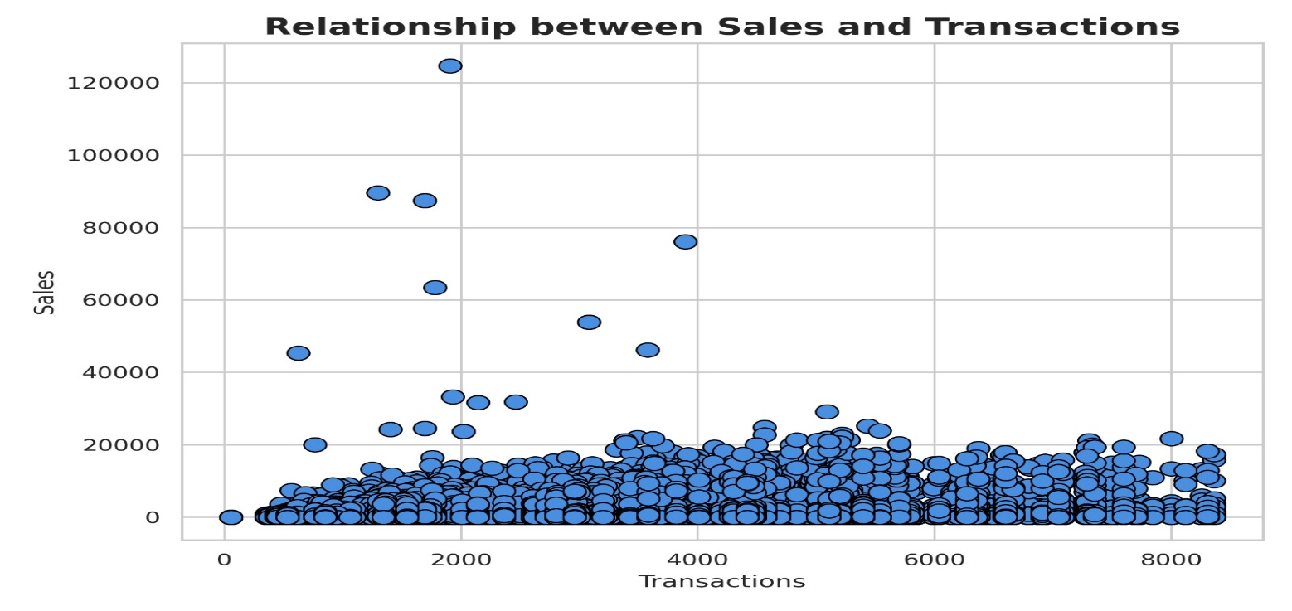
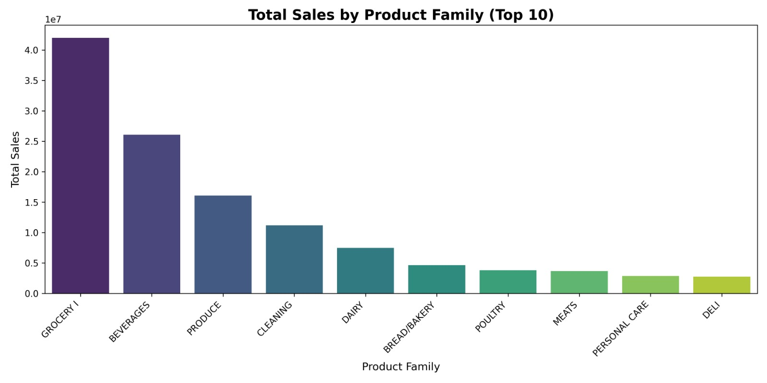
Data Exploration Highlights
Visualized sales by item family and store
Analyzed transaction volume patterns
Identified key trends in holidays and oil prices
Detected seasonality and outliers in sales distribution

Slide 8
Preprocessing Steps
Removed zero or negative sales entries
Applied log(1 + unit_sales) to normalize skewed data
Extracted time features: day, month, year, week
Created rolling windows and average features

Slide 9
Advanced Data Analysis and Feature Engineering

Slide 10
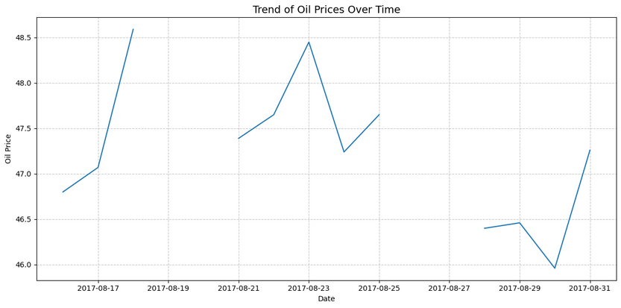
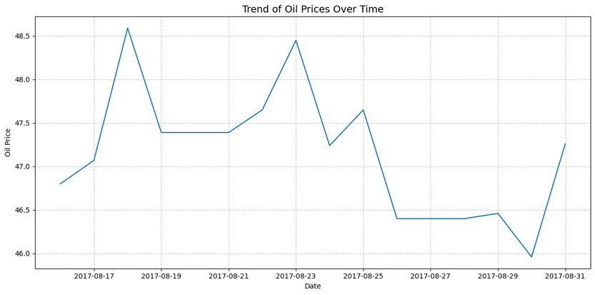
Advanced Feature Engineering
Lag features: 1-day, 7-day, 14-day past sales
Rolling Median
Aggregated sales by store_nbr, family
Count of recent promotions per store
Added external trend features: oil price, holiday flags

Slide 11

Time Series Pattern Discovery
Clear weekly and monthly seasonality detected
Higher sales on weekends and holidays
External signals like oil prices moderately correlated
Used time-based validation: train (2013–2016), test (2017)

Slide 12
Machine Learning Model Development

Slide 13
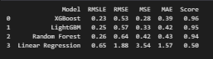
Modeling Strategy
Models Evaluated:
XGBoost
LightGBM
Random Forest Regression
Linear Regression
Training Targets:
log1p-transformed unit_sales
Validation:
RMSLE – Best for big value ranges
RMSE – Highlights large errors more
MSE – Shows overall error
MAE – Simple average error

Slide 14
Model Tuning & Optimization
Applied RandomizedSearchCV
Tuned key params: max_depth, learning_rate, num_leaves, n_estimators
Best performance: XGBoost Model shows a marked improvement in predictive performance

Slide 15
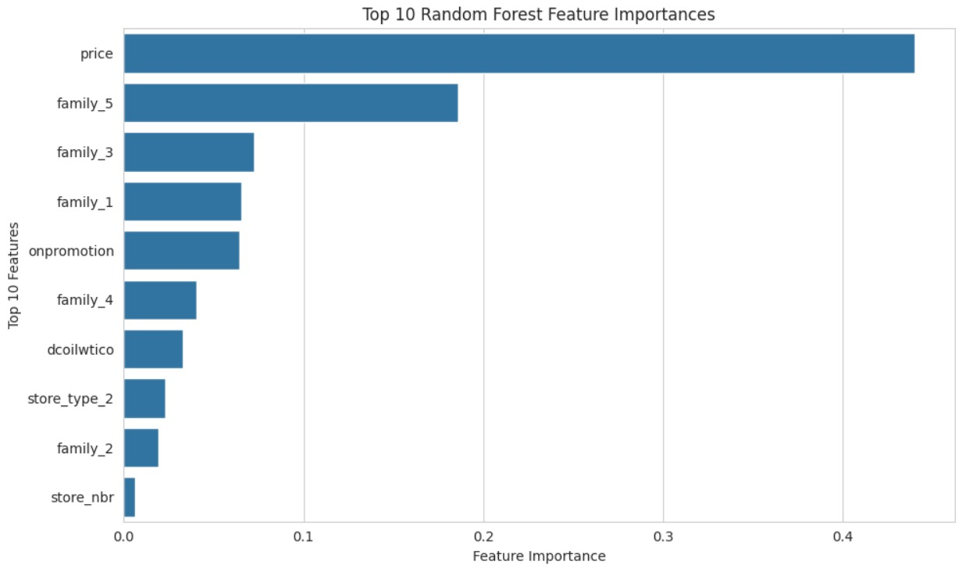
Understanding the Model
Used RandomForest regressor to see which features mattered most
Most important:
Prices
Families 5,3,1,4,2
Onpromotion
Oil prices
Store number and type

Slide 16
Dynamic Pricing
Studied how price affects how much people buy
Tried different price changes to see what boosts profit
Some pricing strategies could increase profits by up to 15%
Helps plan smarter promotions

Slide 17
Results Summary
Best Model : 0.2 RMSLE, 0.44 RMSE, 0.2 MSE, 0.31 MAE, 0.97 SCORE using XGBoost after Hyper Tuning
Forecasts matched real demand closely
Dynamic pricing adds further strategic value

Slide 18

Business Value
Better forecasts mean fewer stockouts and less waste
Smart pricing means better deals and happier customers
Potential to automate pricing in the future

Slide 19
Code and Tools

Slide 20
Code and Tools
What we did:
Cleaned and prepared data
Created helpful features
Built and tuned models
Simulated pricing changes
Used:
Python, Pandas, numpy, matplotlib, seaborn, pickle, scikit-learn
XGBoost, Q Learning

Slide 21
Code and Tools
Notebooks:
Milestone 1: Data collection
Milestone 2: Feature engineering
Milestone 3: Modeling
Milestone 4: Website Integration and Model Deployment

Slide 22
Thank You

